Slide 1
Big Data Architecture and Governance
Group Project | Medium Data Analytics Leaderboard System
Piyush Kumar Sultania
Gauri Narendra Bhale
Nameera Mohsin

Slide 2
01. Velero

Slide 3
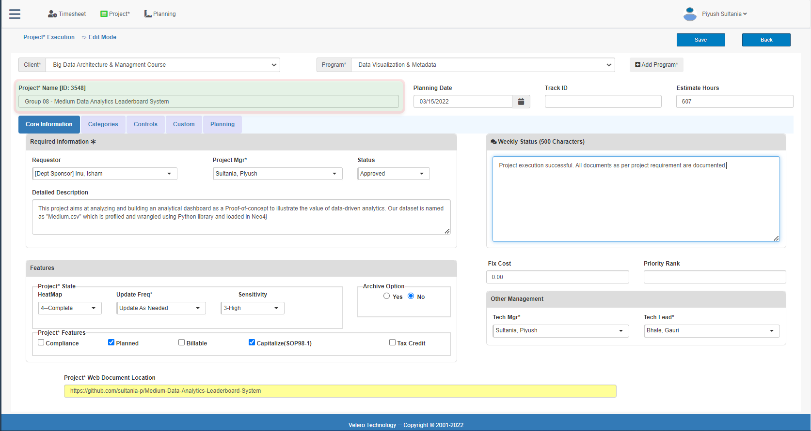
Project Core Information

Slide 4
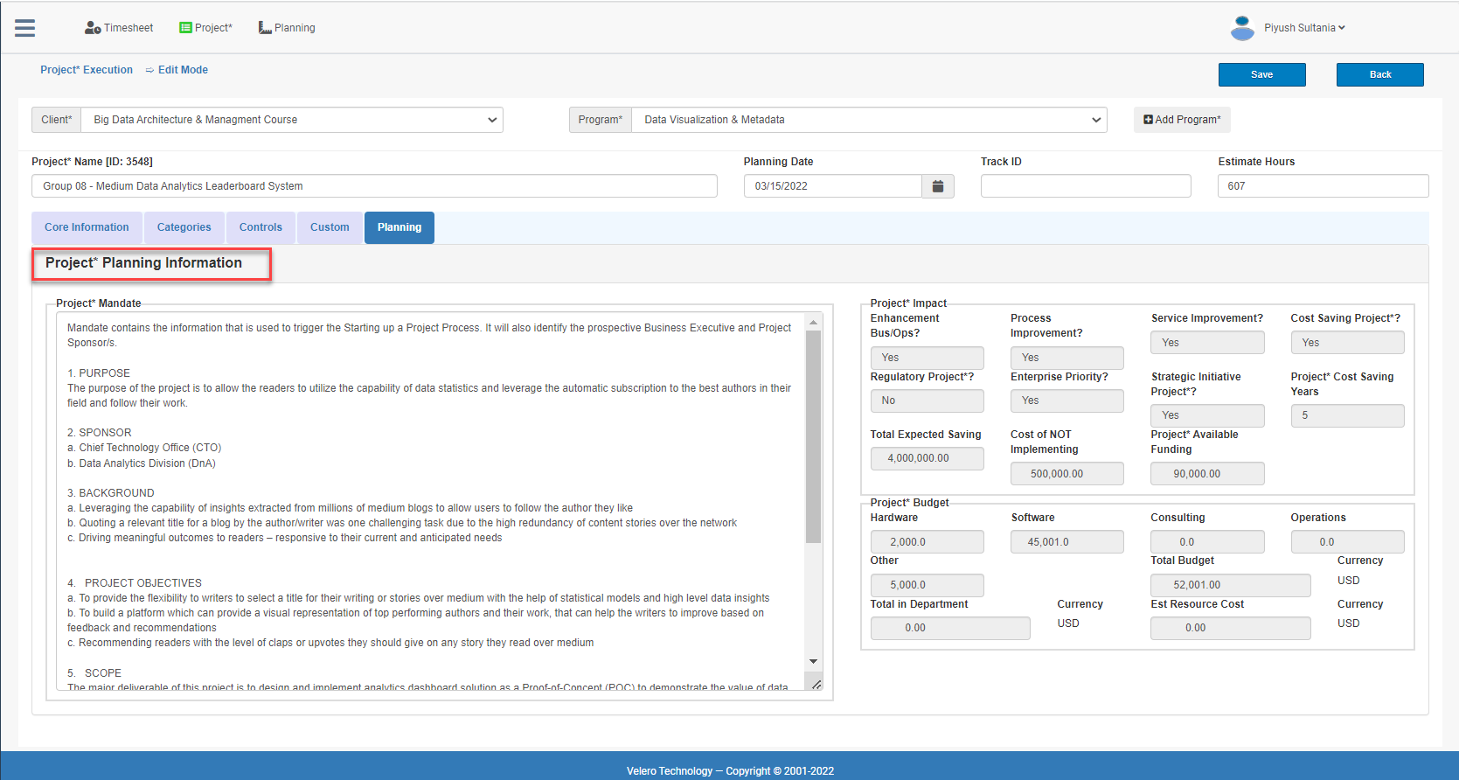
Project Planning (Impact & Mandate)

Slide 5
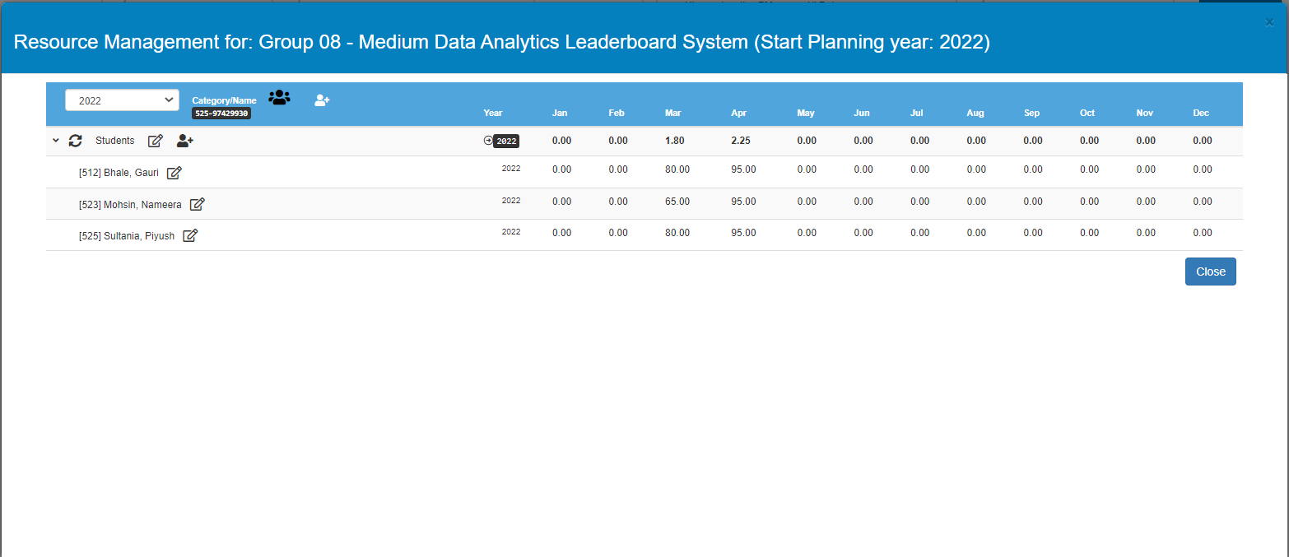
Project Resource Allocation

Slide 6
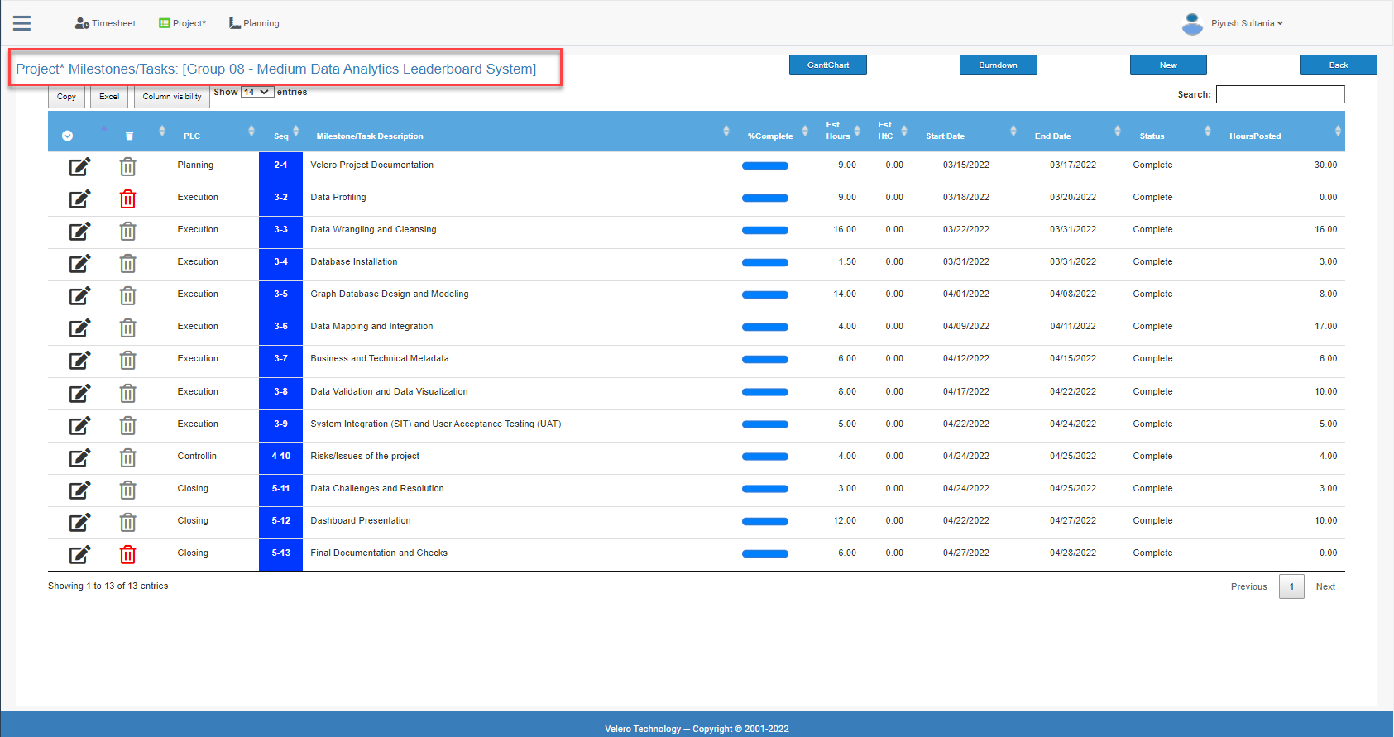
Project Plan

Slide 7
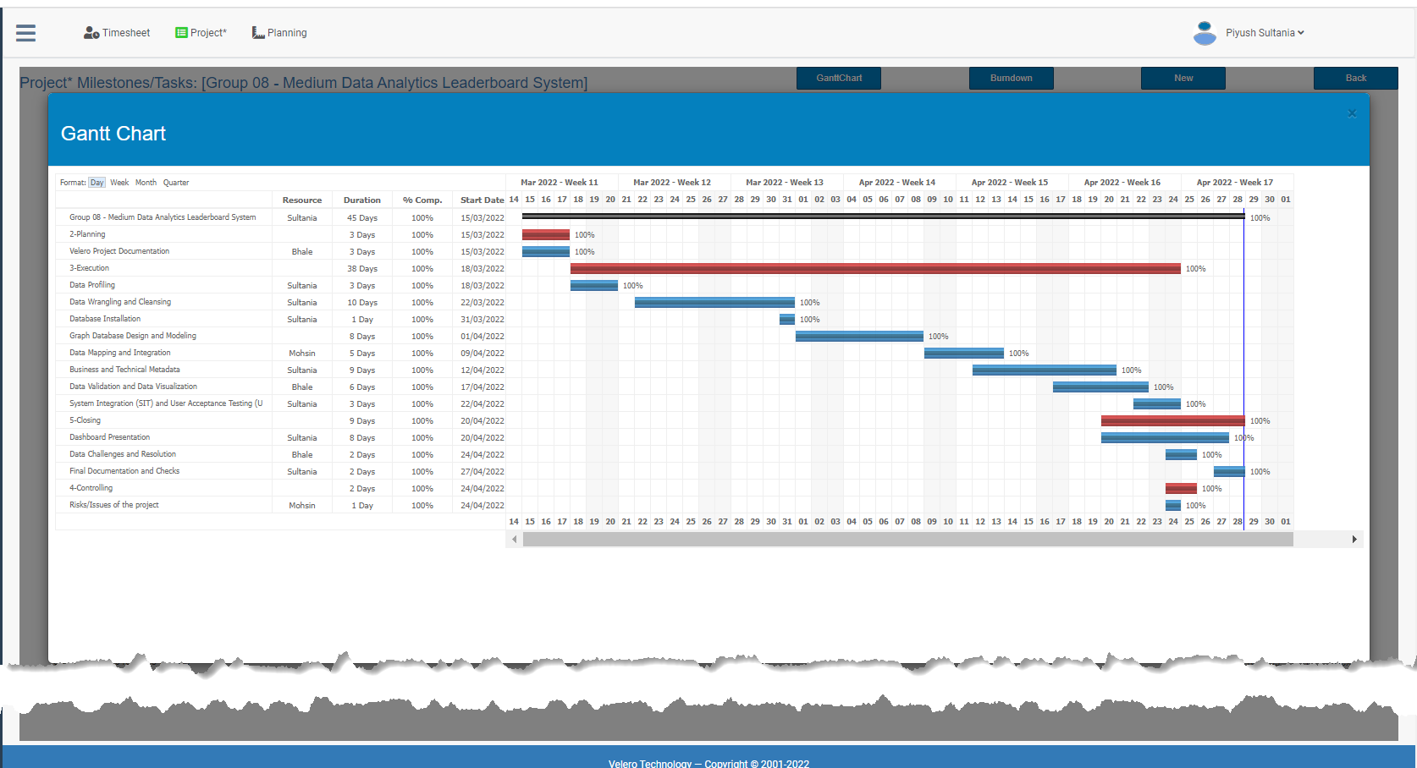
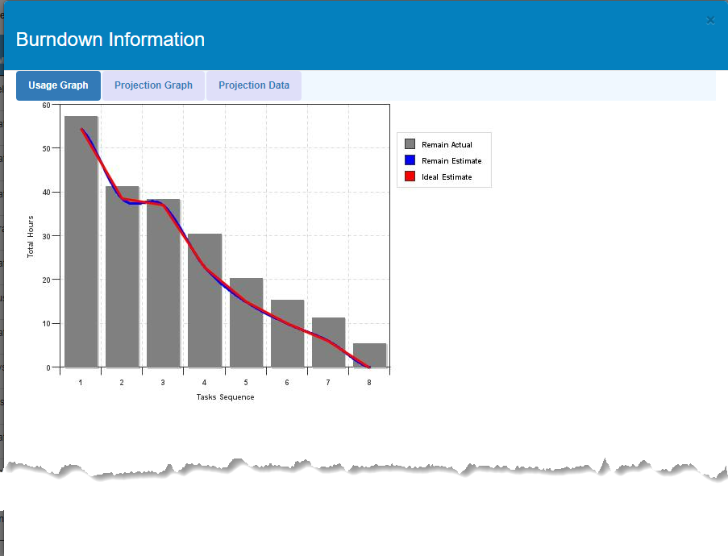
Project Plan (Gantt & Burndown Chart)

Slide 8
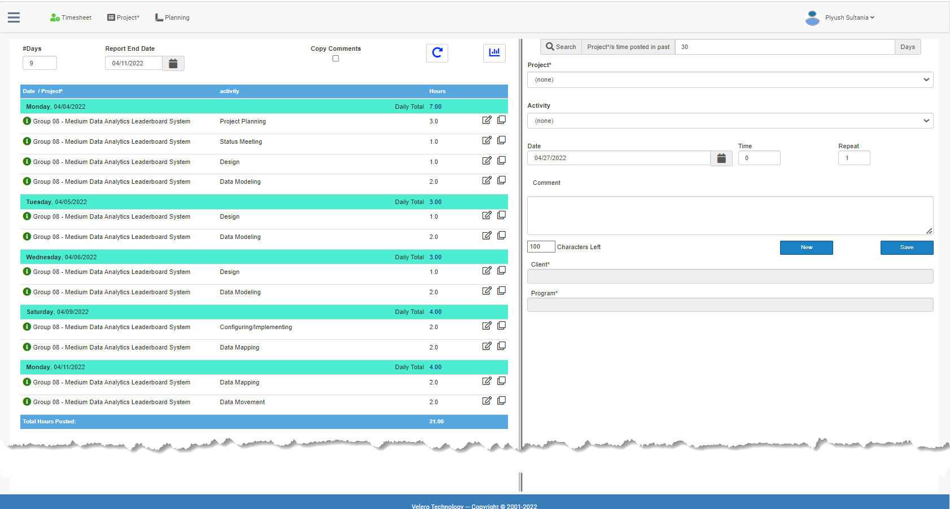
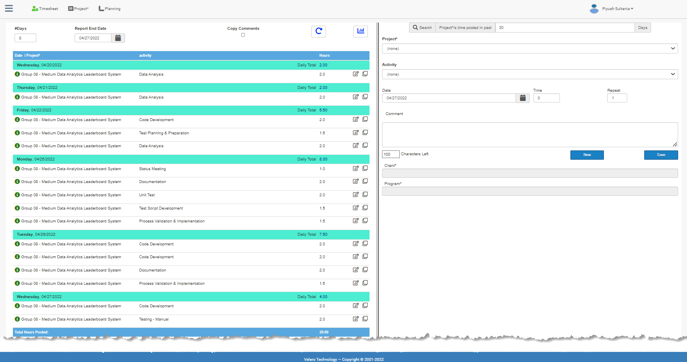
Project Timesheet
Total Clocked Hours: 112 hrs.

Slide 9
02. Data profiling

Slide 10
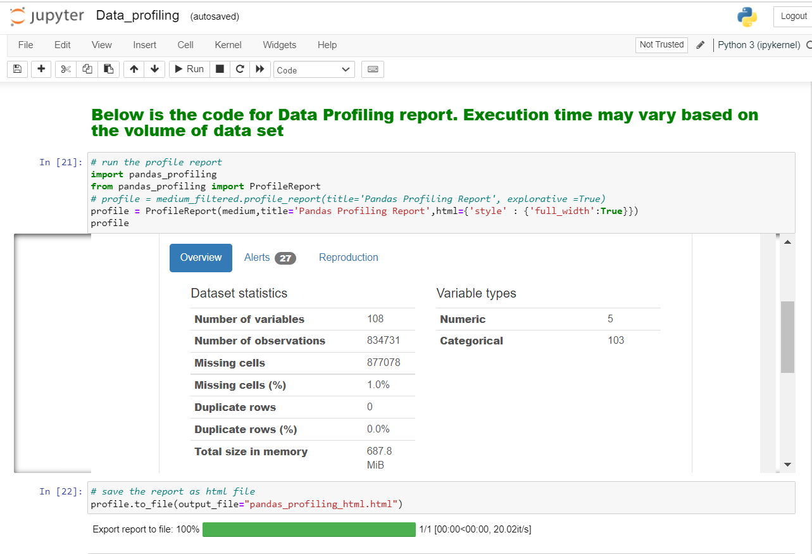
Data Profiling
Data Statistics:
Size: ~650MB
Number of Records: ~1.4M
Number of Columns: 108
Missing Cells(%): 1.0%
Data Profiling Report:

Slide 11
03. Data Wrangling

Slide 12
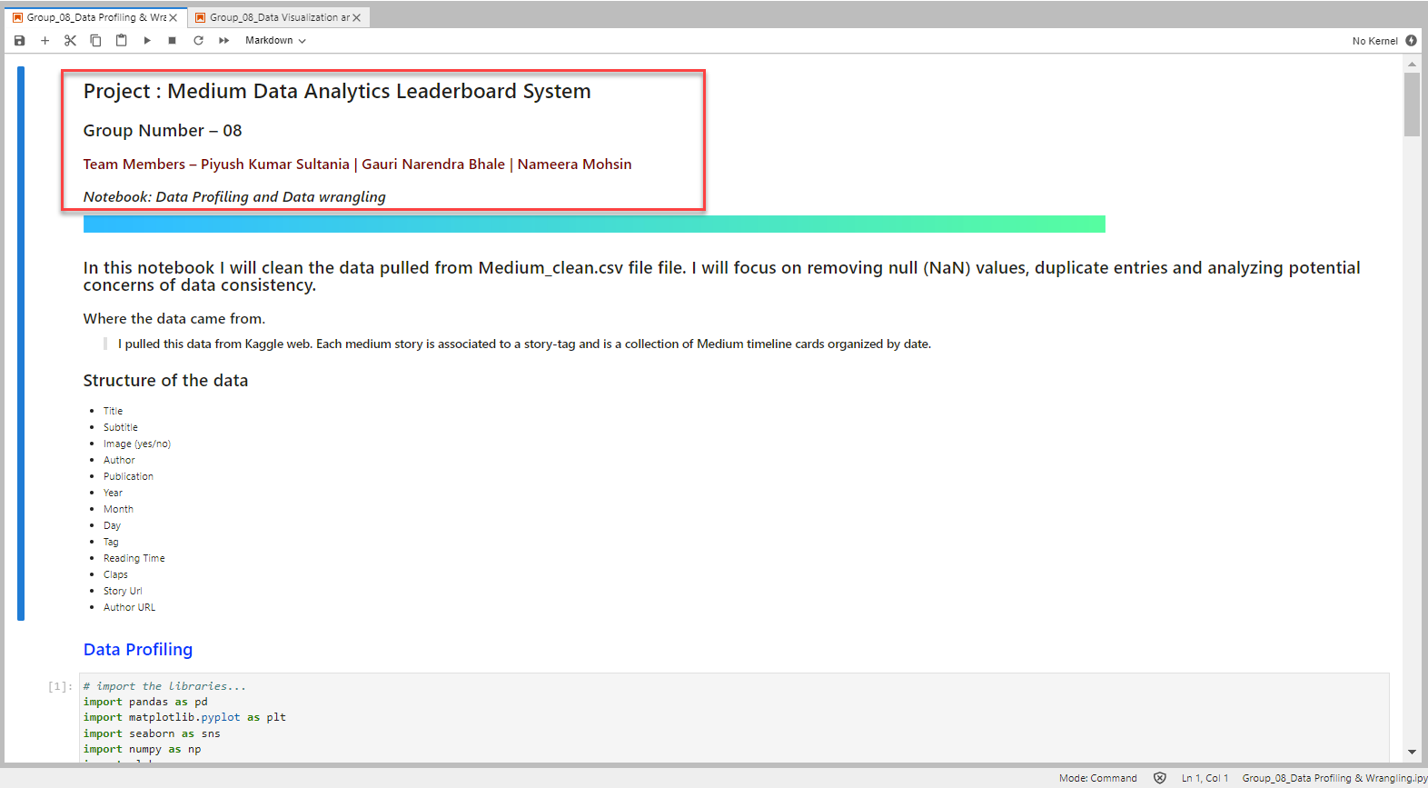
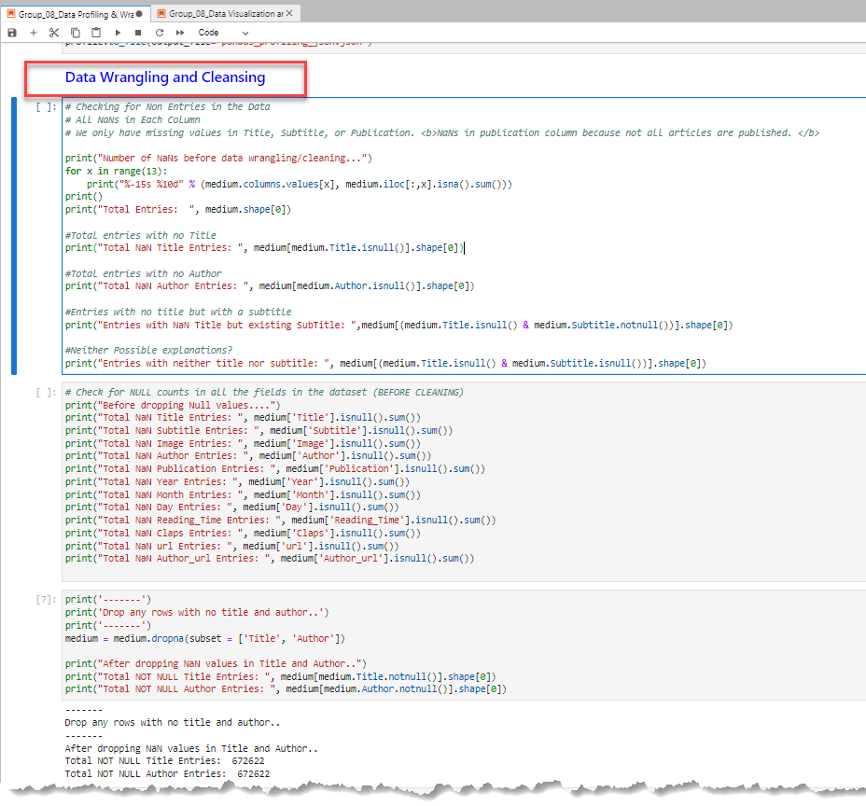
Data Wrangling and Cleansing
Data Statistics:
Pre-Processing
Number of Records: ~1.4M
Number of Columns: 108
Post-Processing
Number of Records: ~575K
Number of Columns: 14
Data Wrangling Activities:
Missing/Blank Values handling
Duplicate records handling
Removing white spaces
Column derivations and transformations
Column renaming
Capitalizing and Titling

Slide 13
04. Neo4j database

Slide 14
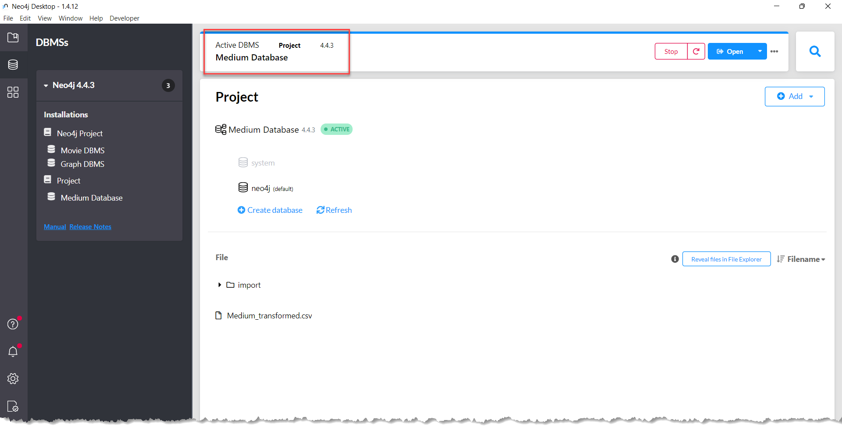
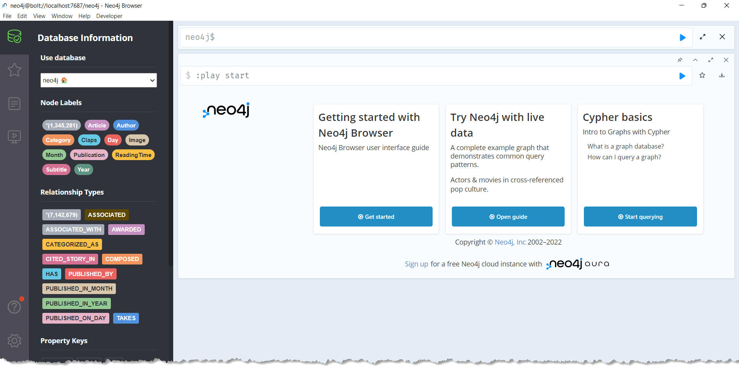
Neo4j Database

Slide 15
05. Neo4j graph database Design & Integration

Slide 16
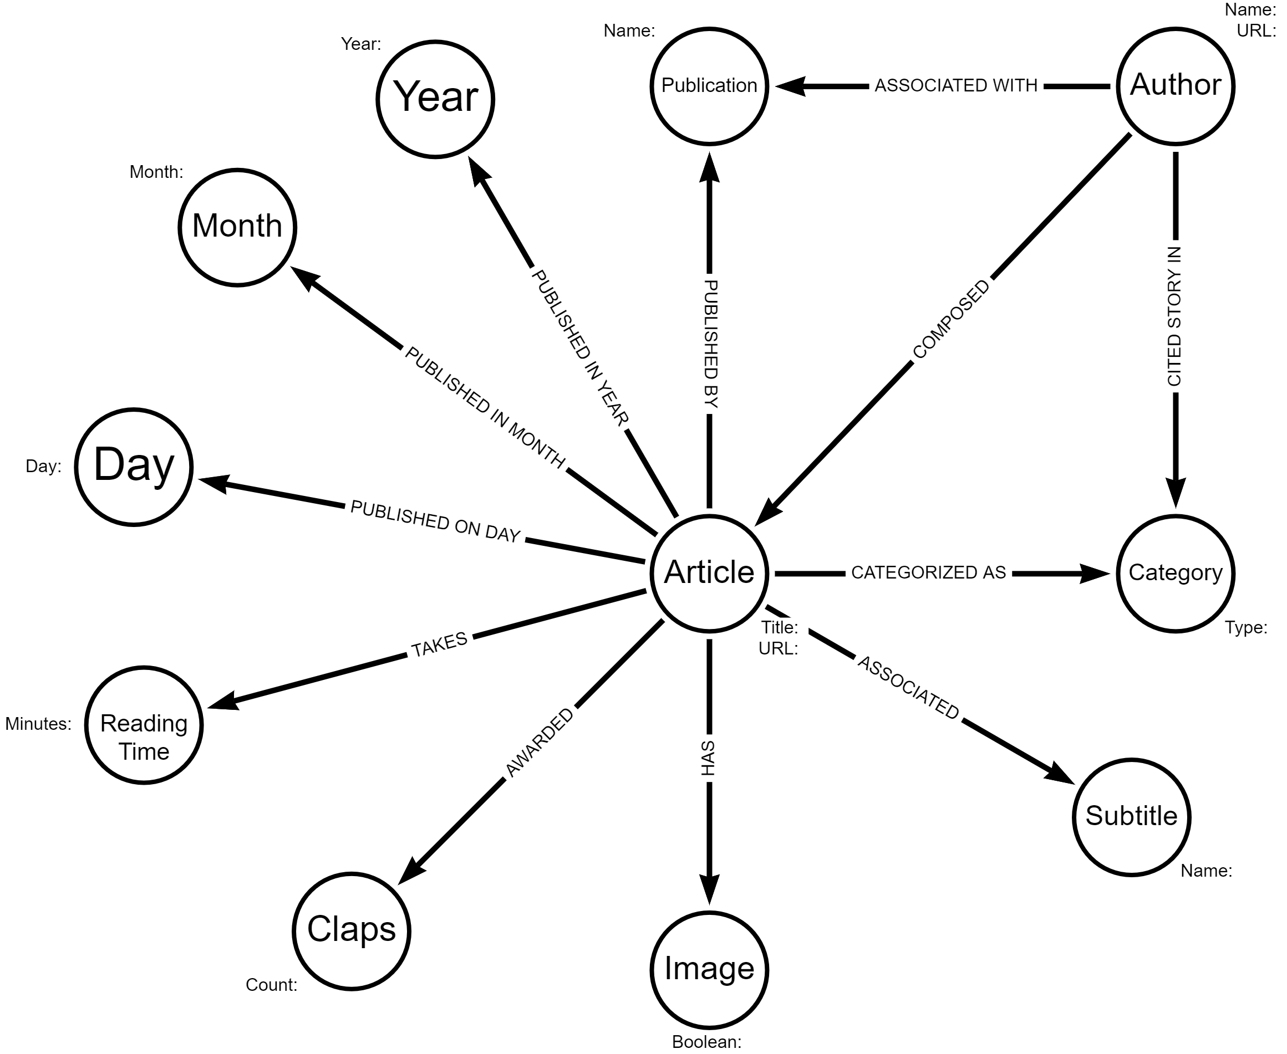
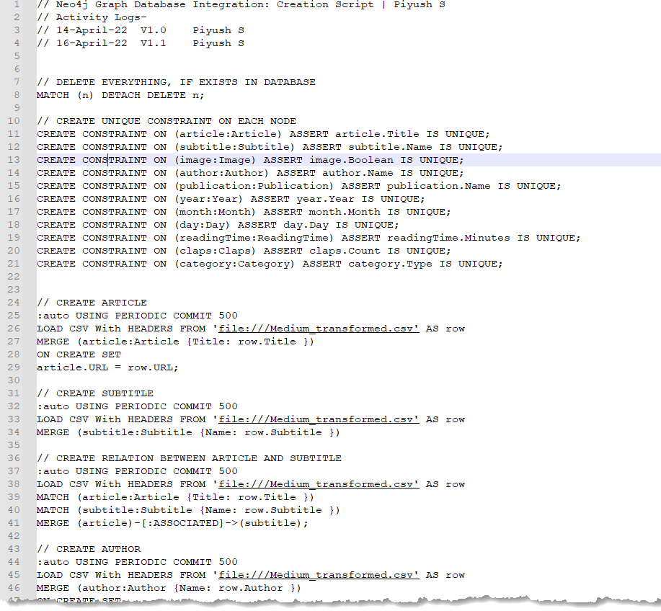
Neo4j Graph Database Design & Integration

Slide 17
06. Business & Technical Metadata

Slide 18
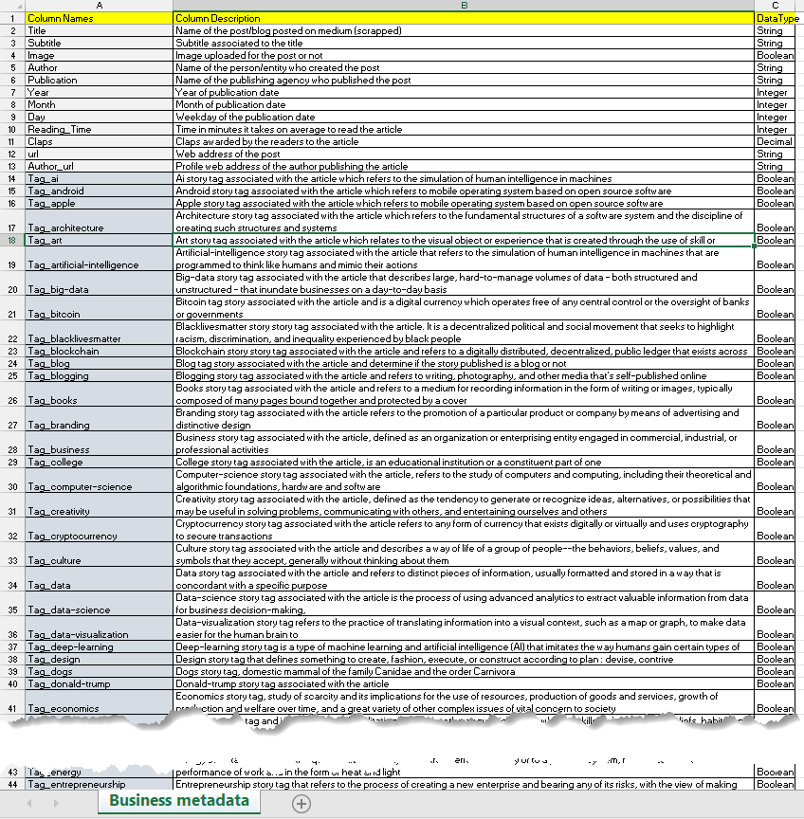
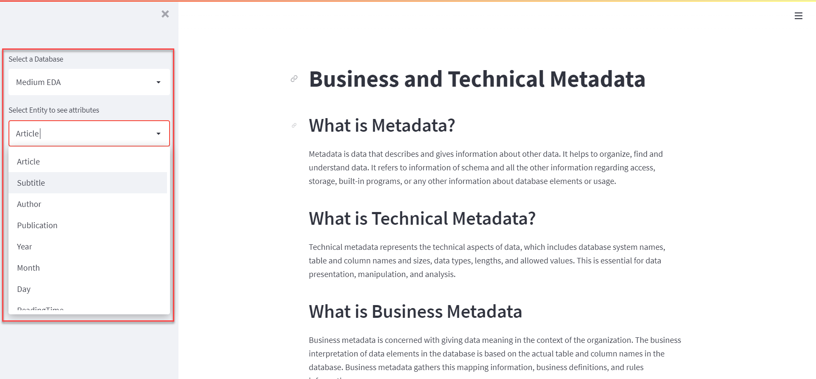
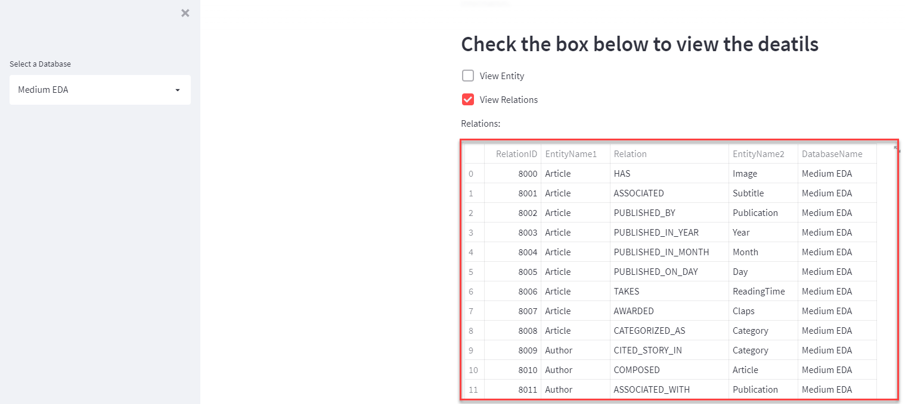
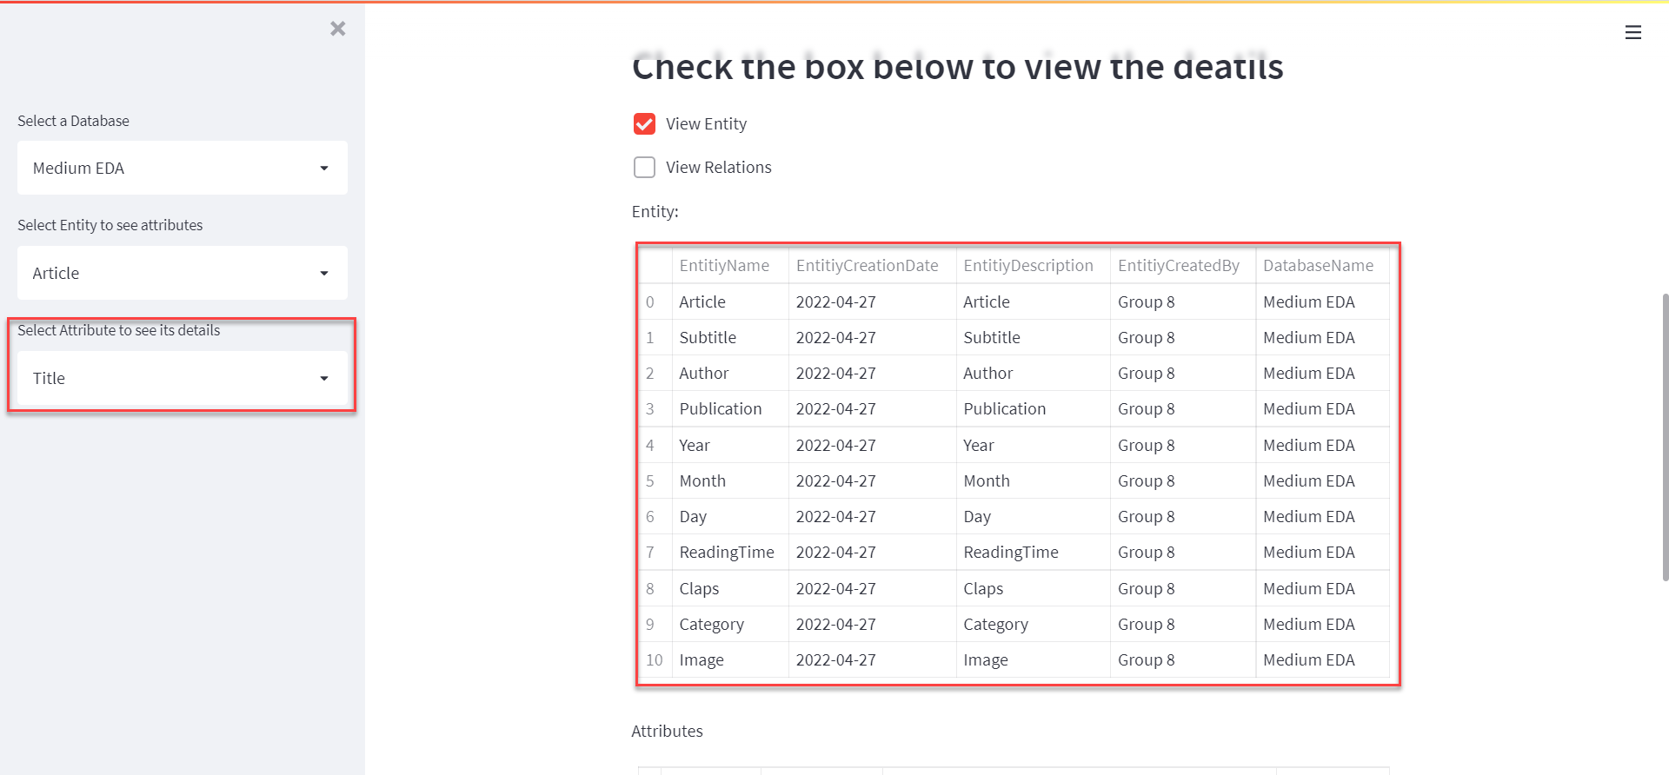
Metadata Representation
Local URL: http://localhost:8501
Network URL: http://10.110.64.165:8501

Slide 19
07. Visualization ASPECTS & insights

Slide 20
Visualization Aspects & Insights
Columns Leveraged as Dimensions for Visualization and Dashboard:
Author
Publication
Category
Year
Month
Columns Leveraged as Metrics for Visualization and Dashboard:
Claps
Reading_Time
Generation of new Dimensions:
Our Medium dataset has one derived dimension “Category” which is derived from various odd tag columns by pivoting the input dataset and picking assigned story tags to each article associated with it. Category column defines the domain of the article or blog published on Medium website. For example, article with Title as “Convert 3G Phone to 4G Phone to support 4G Sim in 3G Mobile” is associated to story tag/Category as “Mobile” which can also be visualized using neo4j graph database.

Slide 21
08. Data Visualization & Dashboard

Slide 22
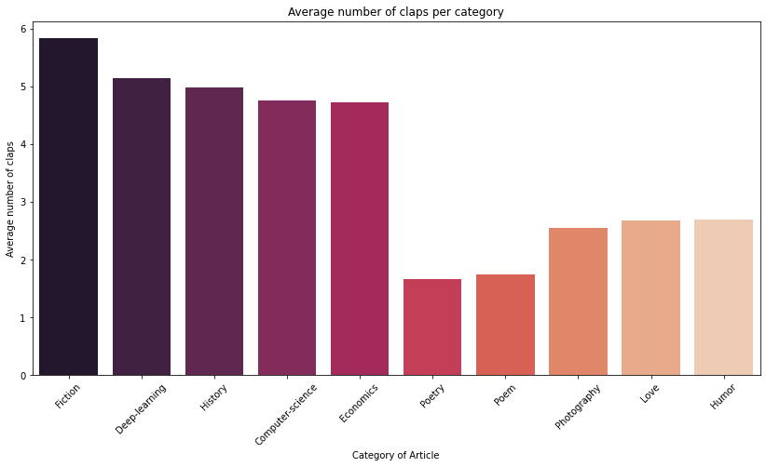
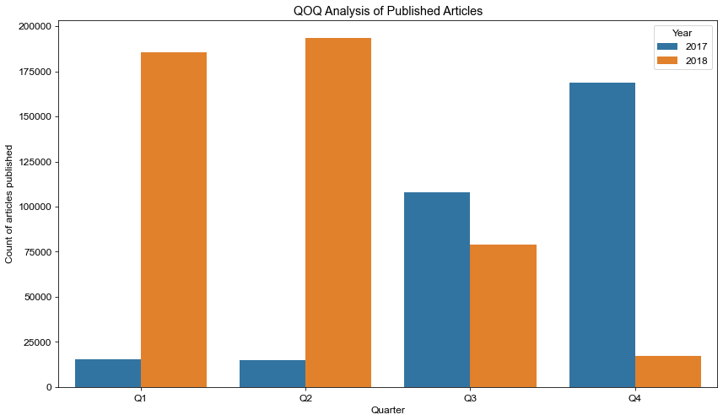
Data Visualization - 01
The bar graph besides represents Average number of claps per category. Fiction category has received highest average claps per category whereas poetry received the least number of claps in each category of article
Quarterly analysis of the published articles is represented in the graph. As shown, in 2018 Q1 and
Q2 recorded more publications of articles than 2017 while in 2017 Q3 and Q4 quarters dominated the earlier phase of the year.

Slide 23
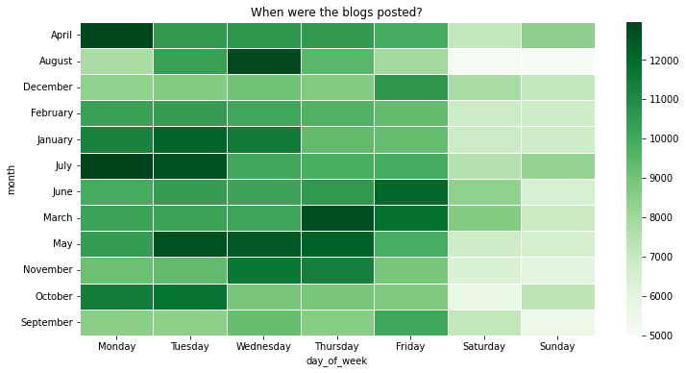
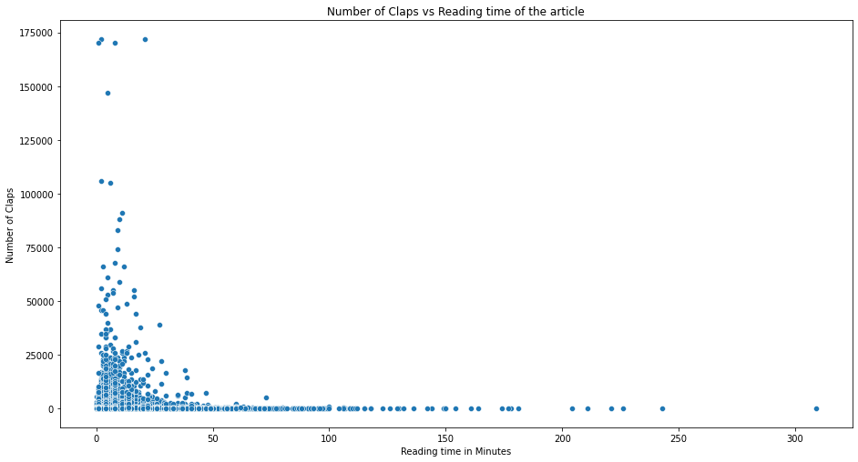
Data Visualization - 02
Heat Map gives us an idea about the peak and off time of article publication. As it is denoted in the heat map every Monday of April is the peak and Saturday/Sunday of August is the off time of publication
The scatter plot represents variation in claps count with reading time of 5 to 10 minutes having significant number of claps, thus depicting the ideal reading time of any article to be in the range of 5-10 minutes

Slide 24
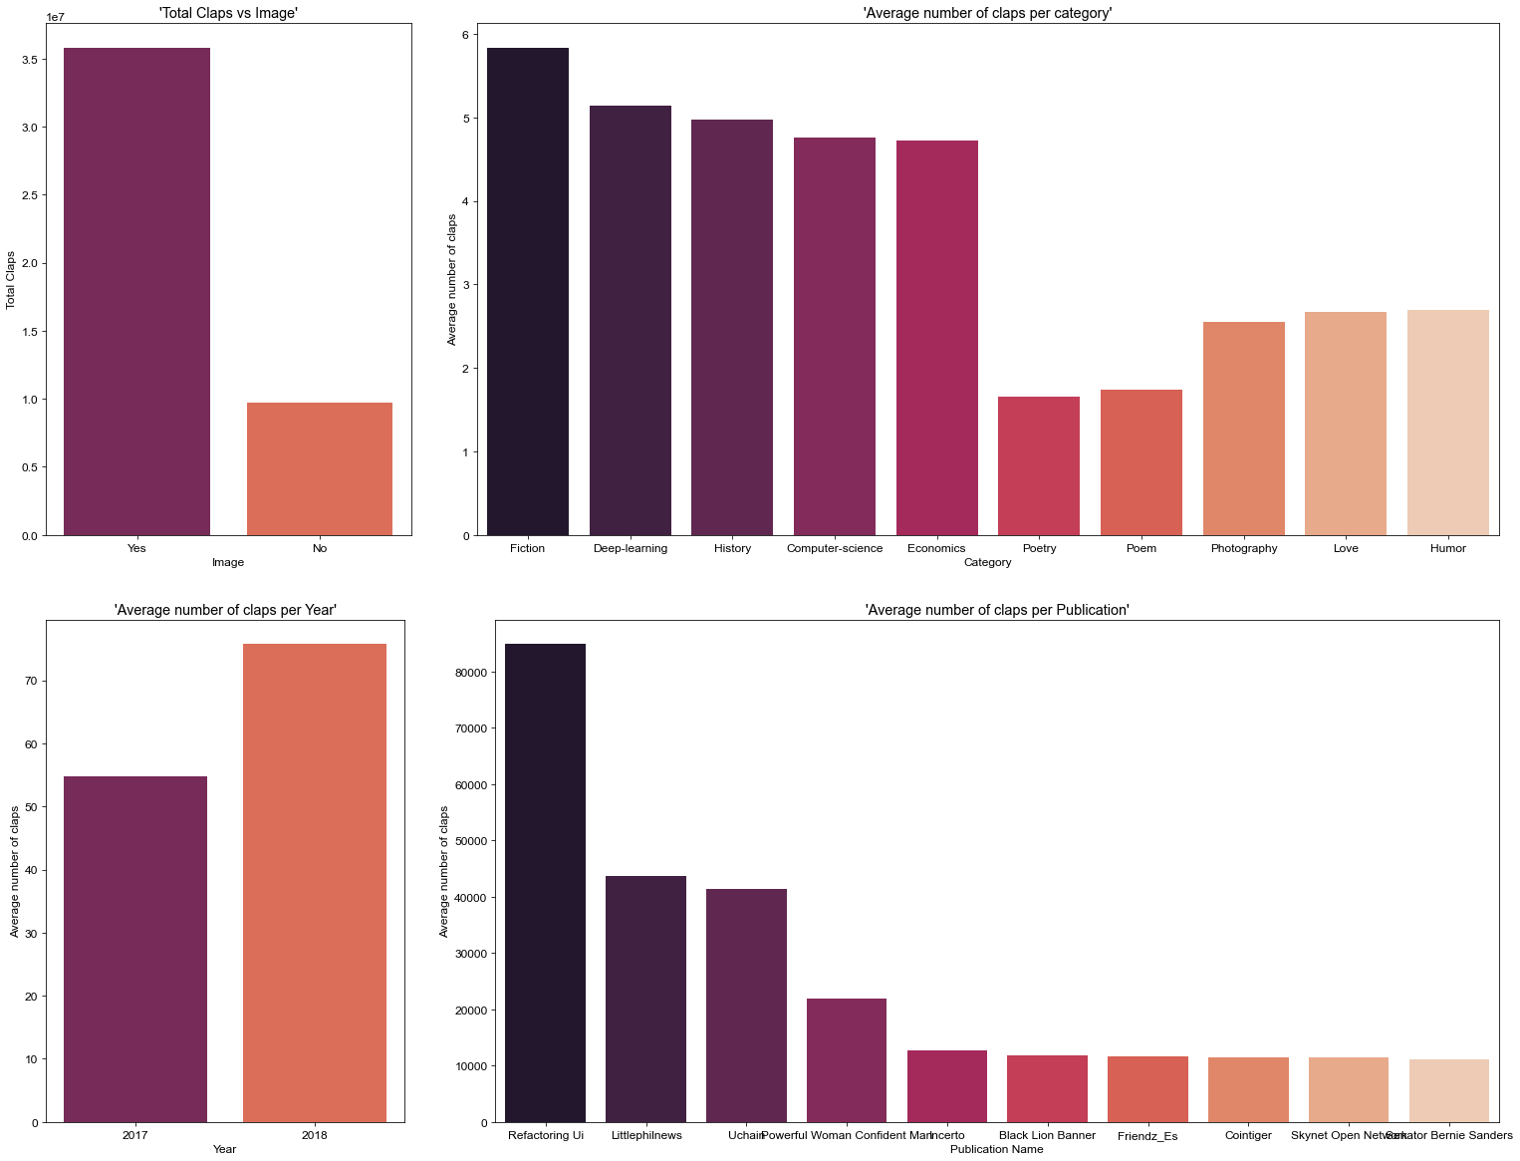
Dashboard – 01(a)
This dashboard shows analysis of claps with different parameters.
Graph 1: Total Claps Vs Image
Graph 2: Avg no of claps Vs Category of Articles
Graph 3: Avg no of claps per year
Graph 4: Avg no of claps per publication

Slide 25
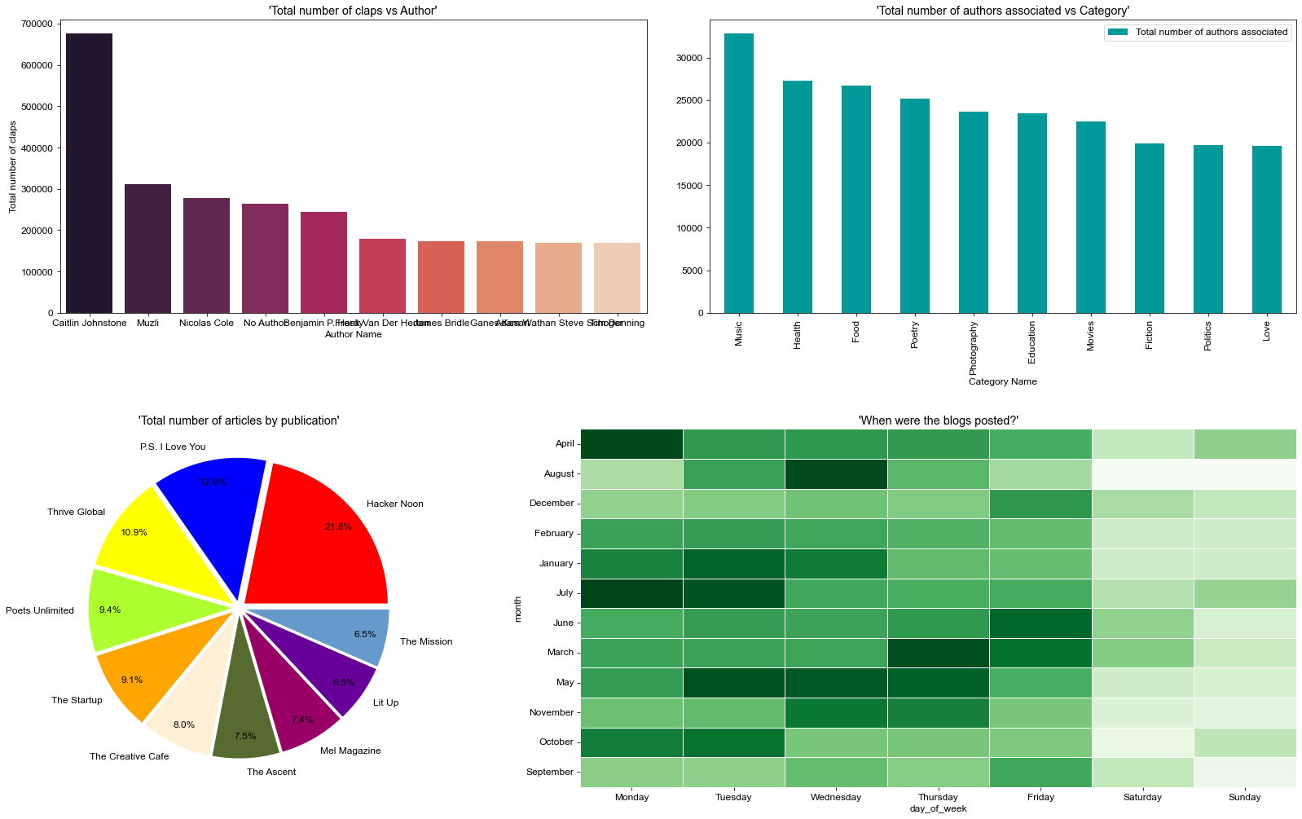
Dashboard – 01(b)
This console represents Author vs different parameters and analysis depending upon publication.
Graph 1: Total number of claps Vs Author name
Gaph2: Authors per Category
Graph3: Pie chart represents analysis of total no of articles by a particular publication
Graph 4: Heat map showcases peak and off time of blog postings

Slide 26
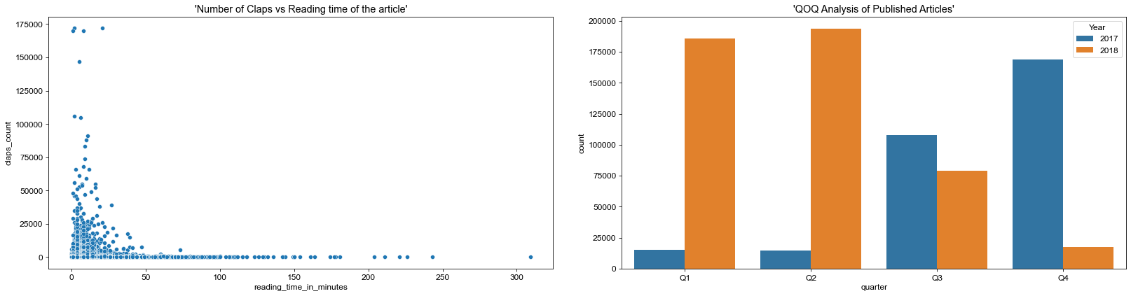
Dashboard – 01(c)
This dashboard represents two different graphs
Graph 1: Scatter plot representing clap count varying upon reading time
Graph 2: Quarterly analysis of the volume of articles published

Slide 27
8. Data VALIDATION & TESTING

Slide 28
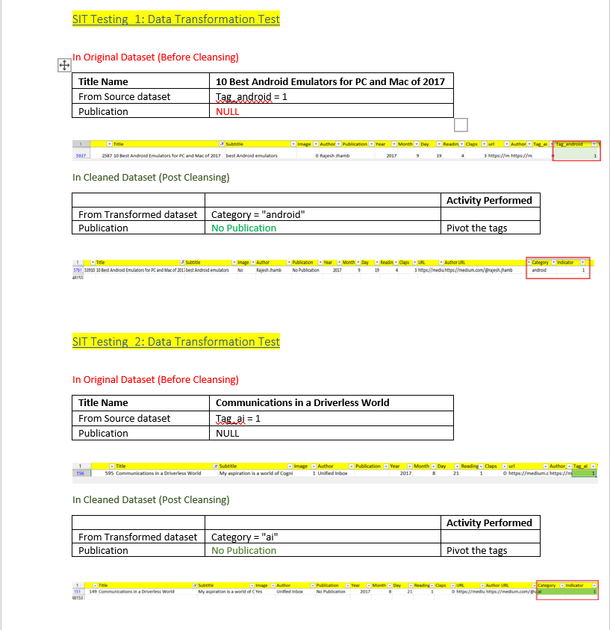
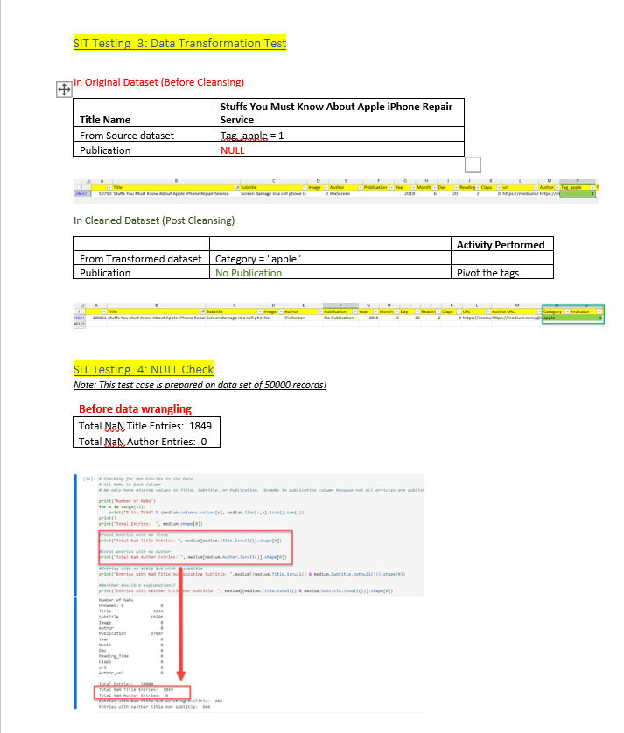
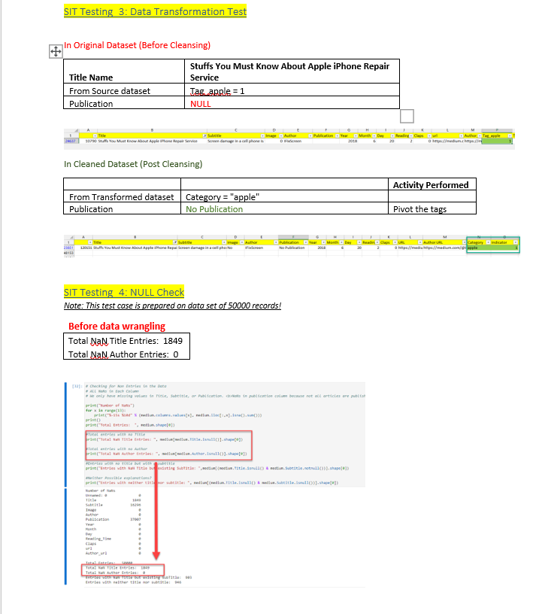
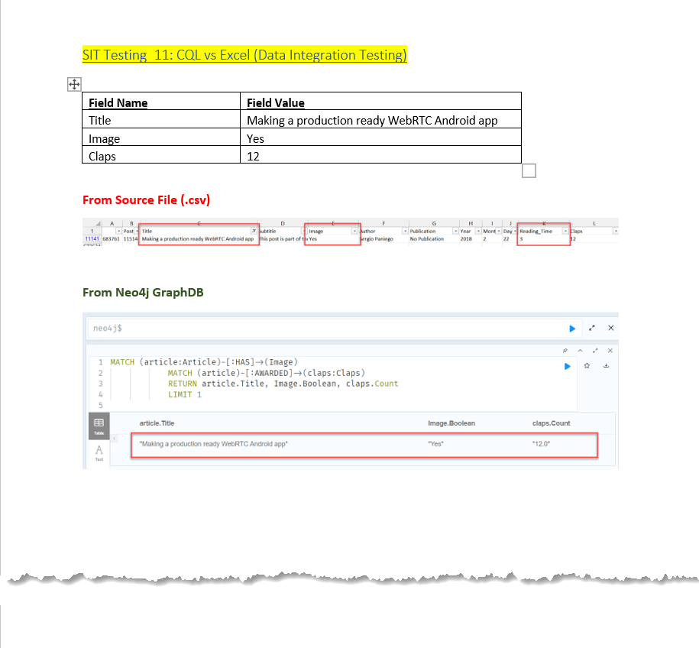
Data Validation & Testing

Slide 29
9. RISK & ISSUES

Slide 30
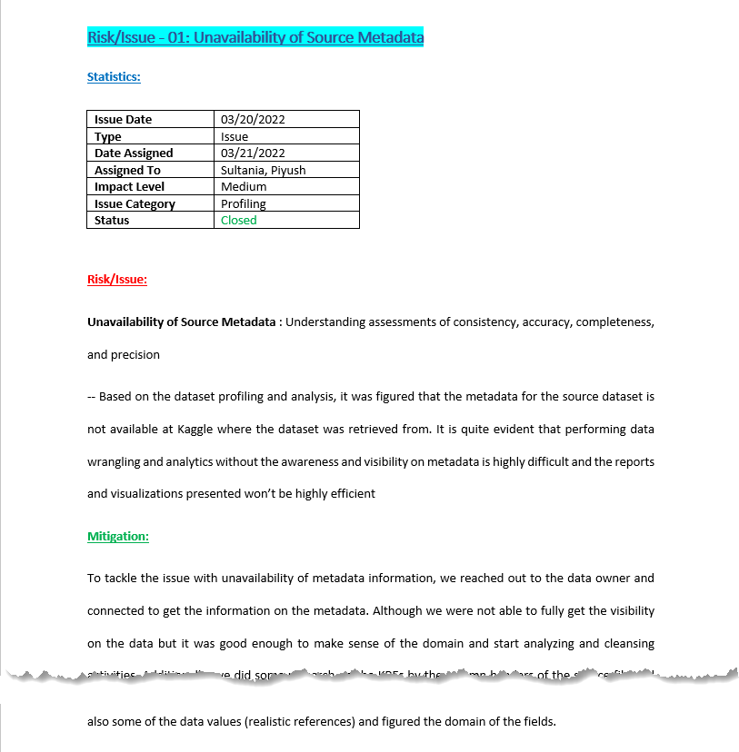
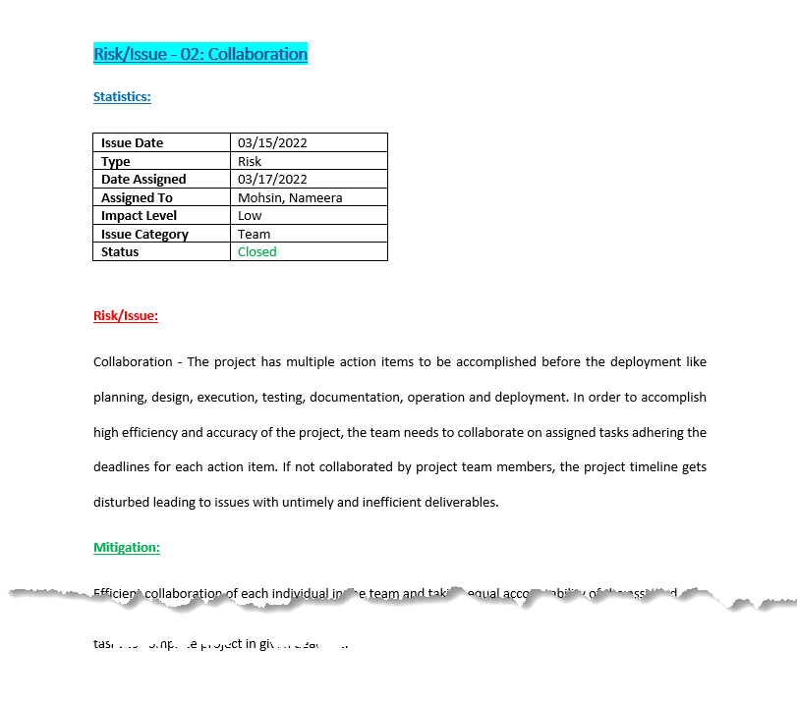
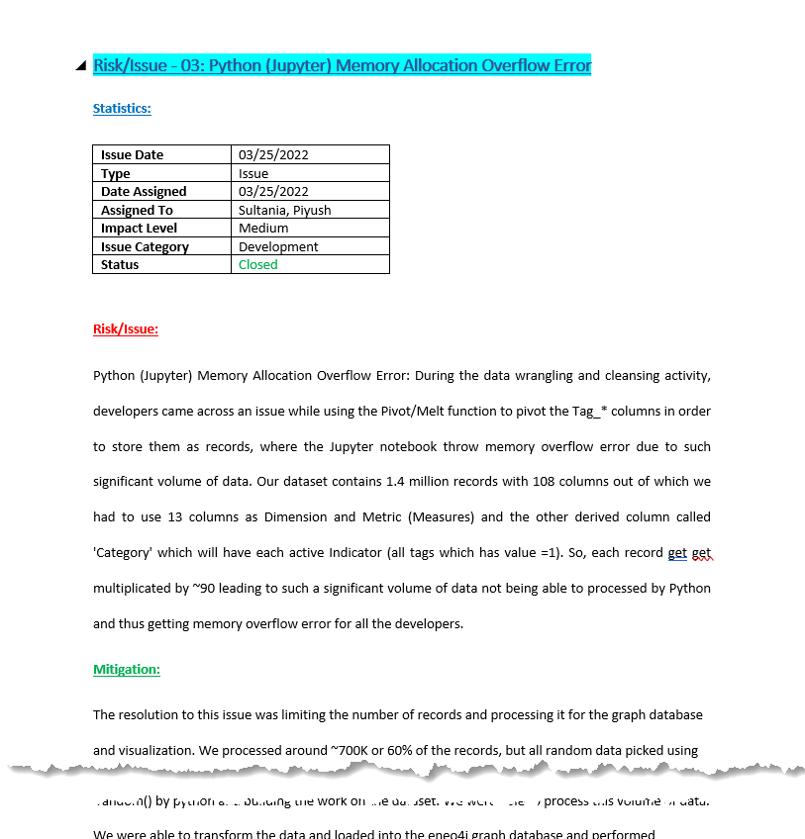
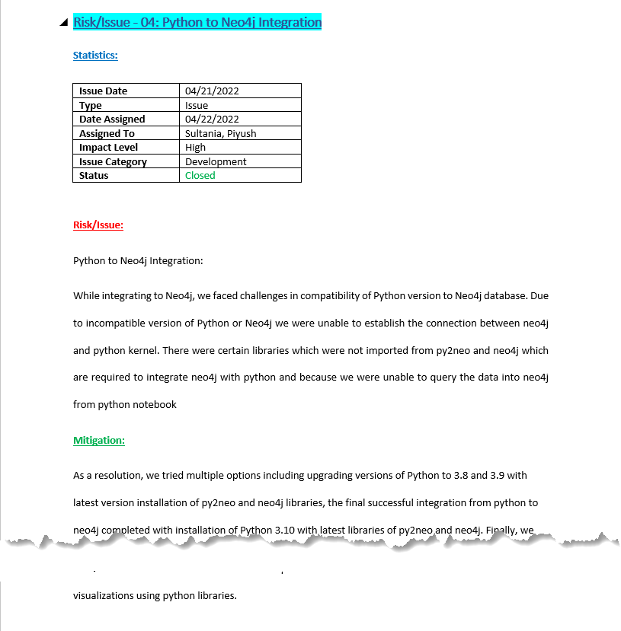
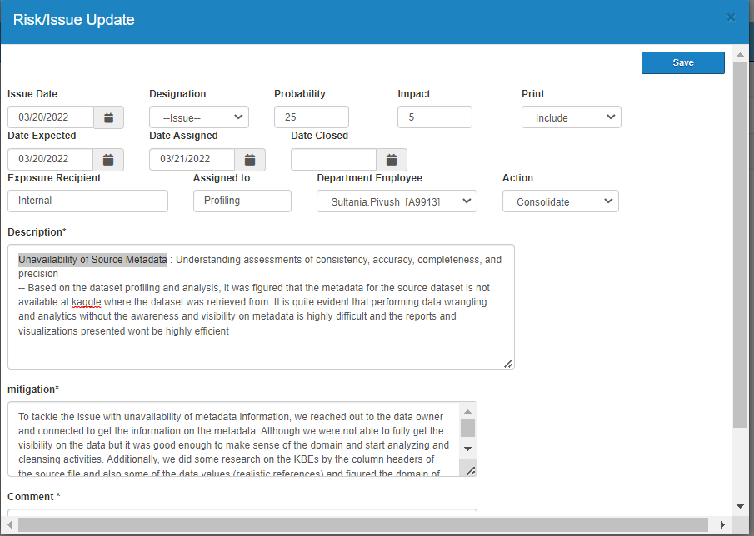
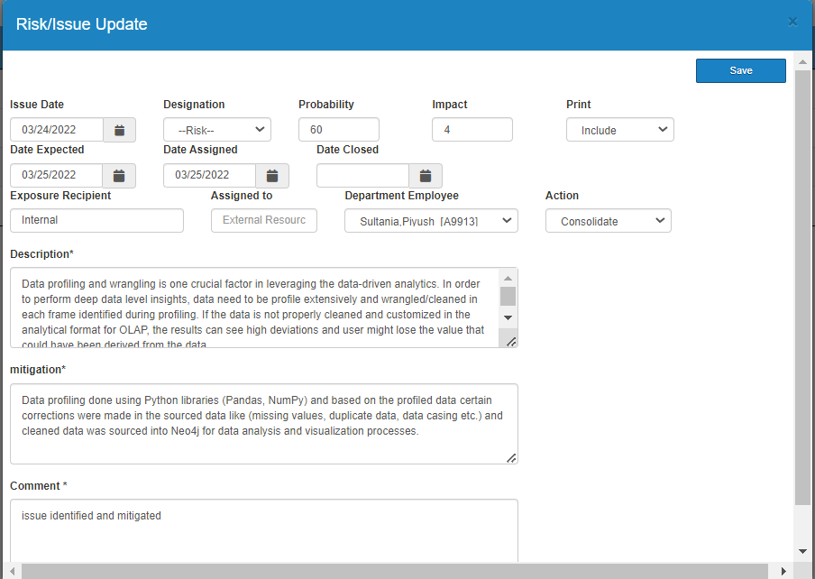
Risk & Issues
Unavailability of Source Metadata
Resource Provisioning with Access
Risk with Improper Data Cleaning
Lack of Team Collaboration
Python to Neo4j Integration Challenge

Slide 31
10. Data Challenges & Resolution

Slide 32
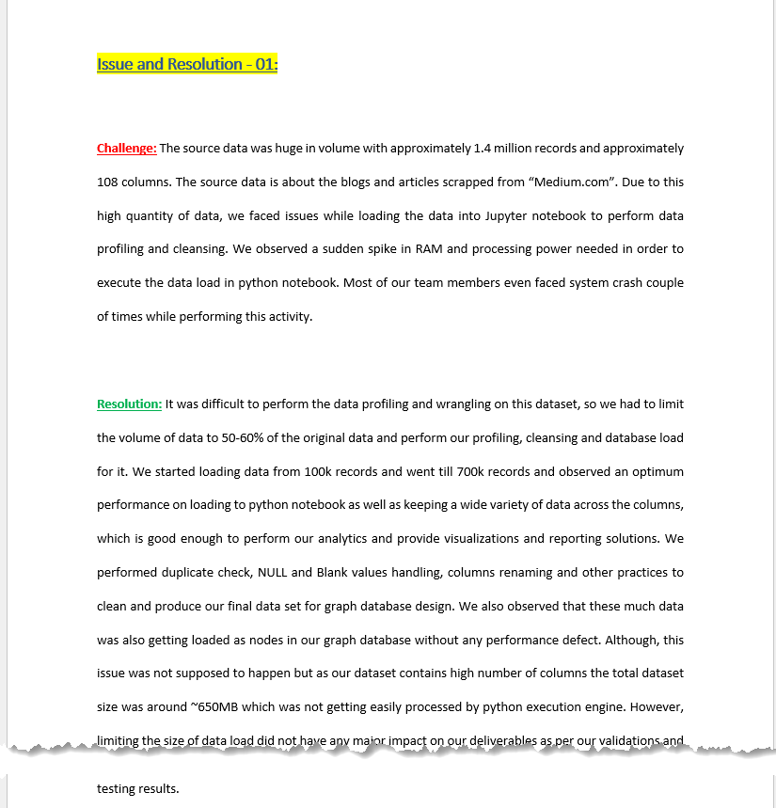
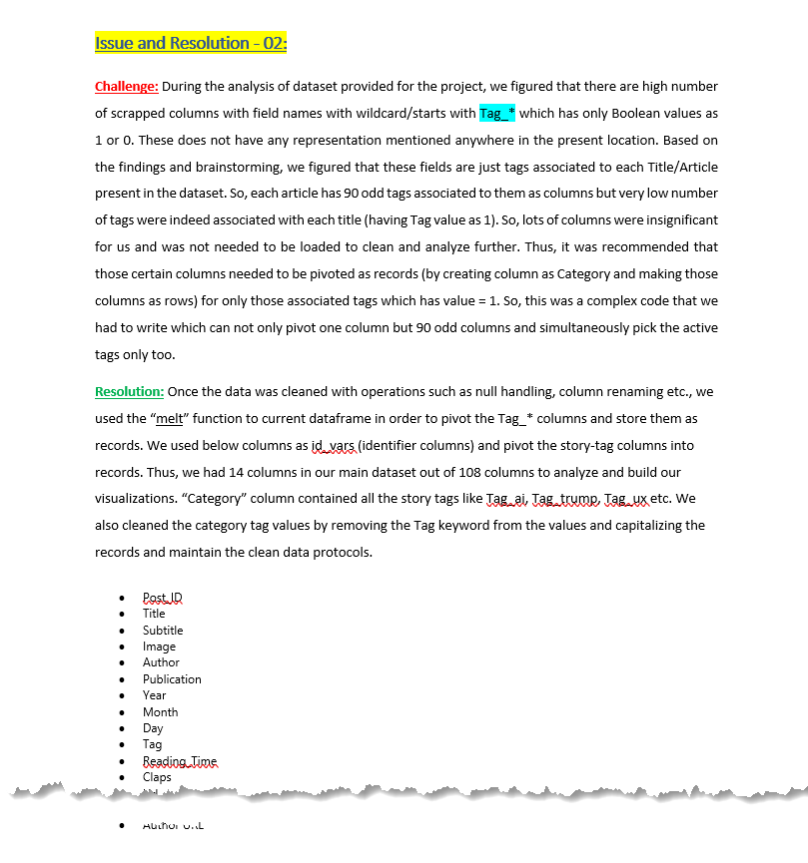
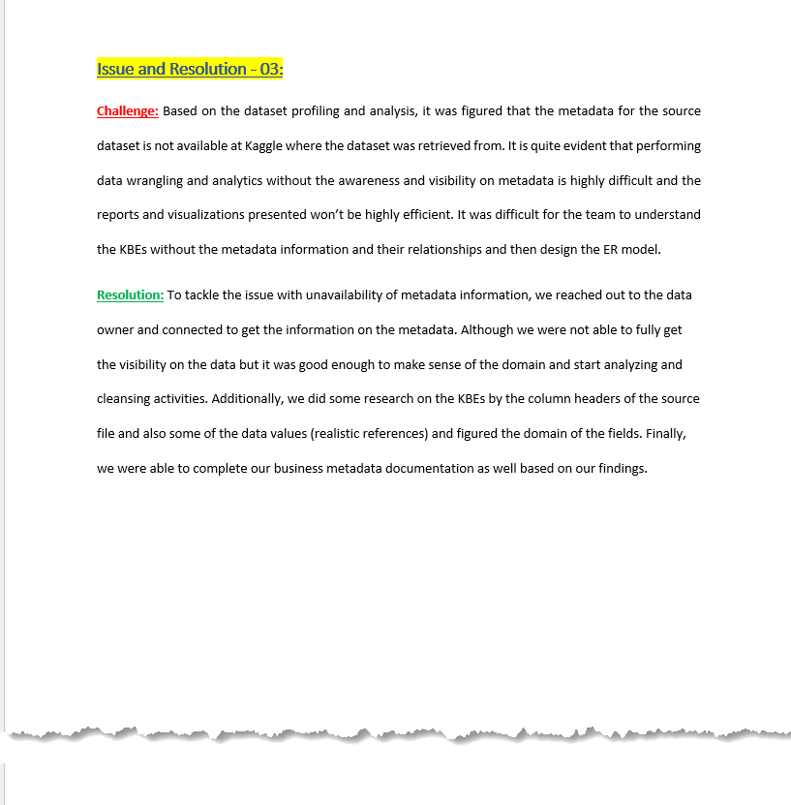
Data Challenges & Resolution
High Volume of raw data
Unavailability of metadata information
Inconsistent dataset

Slide 33
Thank You!

